Slide 1

Part 3
Management: Empowering People to Achieve Business Objectives

Slide 2
Chapter 8
Management, Leadership, and the Internal Organization

Slide 3

Chapter Objectives
Define management and the three types of skills necessary for managerial success.
Explain the role of vision and ethical standards in business success.
Summarize the major benefits of planning and distinguish among strategic planning, tactical planning, and operational planning.
Describe the strategic planning process.
Contrast the two major types of business decisions and list the steps in the decision-making process.
Define leadership and compDepartmentalizationrship styles.
Discuss the meaning and importance of corporate culture.
Identify the five forms of departmentalization and the four main types of organization structures.

Slide 4

What is Management?
Management—process of achieving organizational objectives through people and other resources.
Notes:
Management is the process of achieving organizational objectives through people and other resources. The management hierarchy depicts the hierarchical levels of management in organizations:
1.Top managers provide overall direction for company activities
2. Middle managers implement the strategies of top managers and direct the activities of supervisors
3. Supervisors, interact directly with workers.

Slide 5
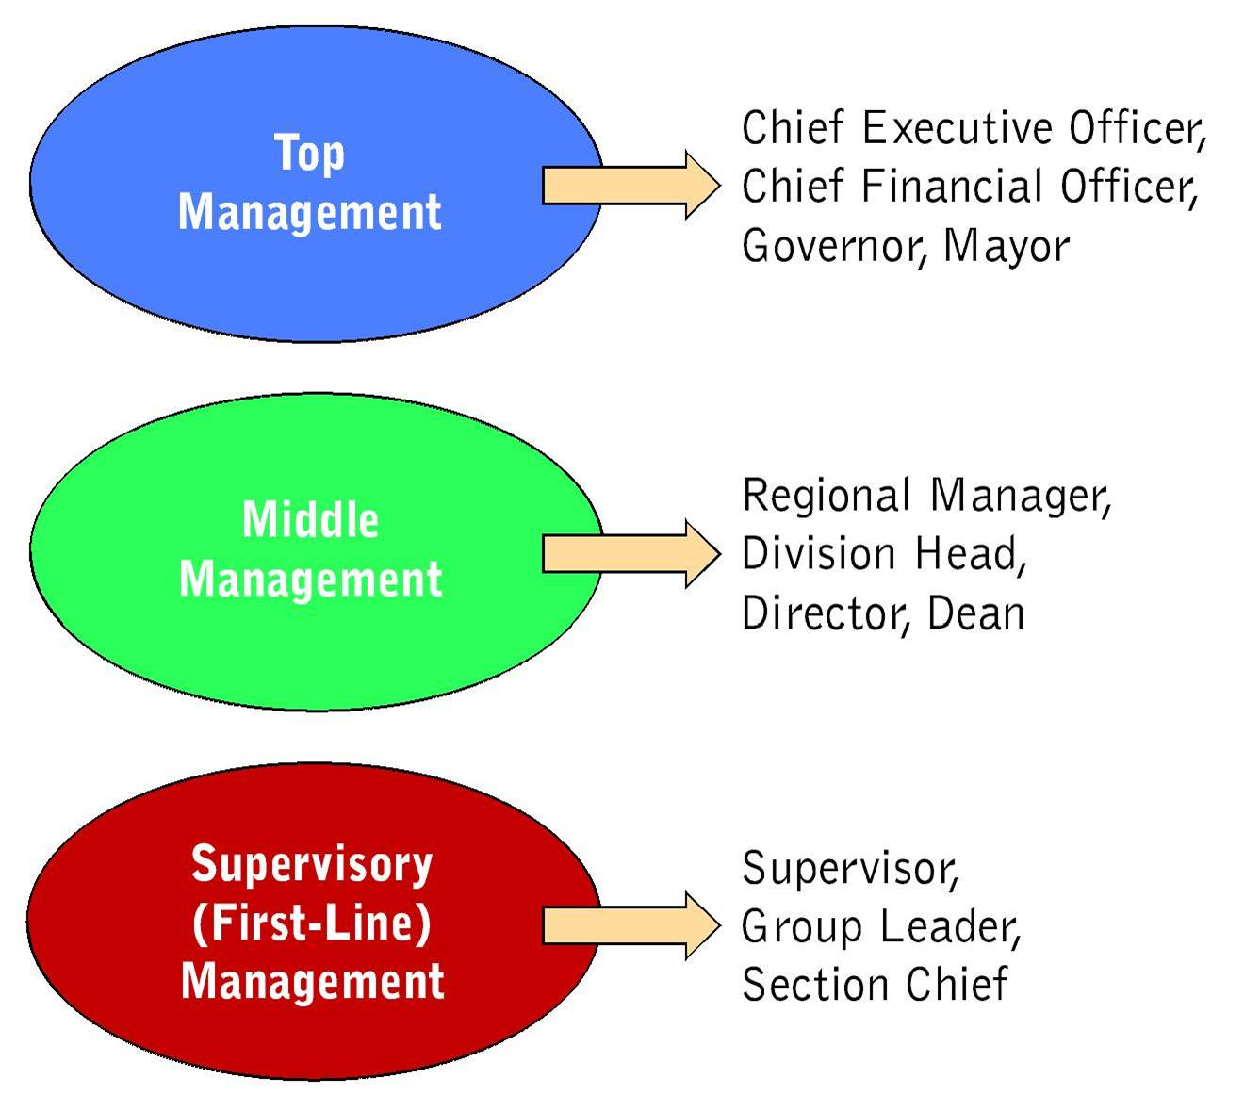
The Management Hierarchy

Slide 6
The Management Hierarchy
Top Management
  The highest level of management—chief executive officer, chief financial officer, and executive vice president
  Devote most of their time to developing long-range plans
  Make decisions regarding new product introduction, the purchase of other companies, or entry into new geographic markets
  Set a direction for their organization and inspire the company’s employees to achieve their vision
Notes:
Top Management
a. includes positions such as CEO, CFO, and executive vice presidents
b. devote most of their time to developing long-range plans
c. set a direction for their organization and inspire the company’s executives and employees to achieve their vision for the company’s future
d. spend much of their time building good relationships between the company and the public

Slide 7
The Management Hierarchy
Middle Management
  Second tier in the management hierarchy – includes positions like general managers, plant managers, division managers, and branch managers
  Attention focuses on specific operations, products, or customer groups within an organization
Notes:
Middle Management
a. includes positions such as general managers, plant managers, division managers, and branch managers
b. focus attention on specific operations, products, or customer groups
c. responsible for developing detailed plans and procedures to implement the firms’ strategic plans

Slide 8
The Management Hierarchy
Supervisory Management
  First-line management—includes positions such as supervisor, line manager, and group or team leader
  Directly responsible for assigning nonmanagerial employees to specific jobs and evaluating their performance every day
Notes:
Supervisory Management or First-Line Managers
a. includes positions such as supervisor, line manager, and group or team leader
b. are directly responsible for assigning non-managerial employees to specific jobs or evaluating their daily performance
c. they work in direct and continuing contact with the employees who produce and sell the firms’ goods and services
d. responsible for implementing plans developed by middle managers, which is often accomplished by providing technical assistance and motivating workers

Slide 9
Skills Needed for Managerial Success
Technical skills—ability to understand and apply the techniques, knowledge, and tools and equipment of a specific discipline or department
Human skills—interpersonal skills that enable a manager to work effectively with and through people
Conceptual skills—ability to see the organization as a unified whole and to understand how each part of the overall organization interacts with other parts
Notes:
Technical Skills
a. the manager’s ability to understand and use techniques, knowledge, and tools and equipment of a specific discipline or department
b. particularly important for first-line managers, but are somewhat important even as individuals move up the managerial hierarchy
Human Skills
a. the interpersonal skills that enable a manager to work effectively with and through people
b. include the ability to communicate with, motivate, and lead employees to accomplish assigned tasks
c. these skills are needed in working with people both internal and external to the organization
d. increasing globalization has intensified the need for these skills throughout all managerial levels
e. many companies are becoming increasingly focused on developing these skills in their employees and managers
Conceptual Skills
a. determine a manager’s ability to see the big picture by acquiring, analyzing, and interpreting information
b. especially important for managers at the upper levels, who must develop long-range plans

Slide 10
What is Management?
Managerial Functions
  Planning—process of anticipating future events and conditions and determining courses of action for achieving organizational objectives.
  Organizing—means by which managers blend human and material resources through a formal structure of tasks and authority

Slide 11
What is Management?
Managerial Functions
  Directing—guiding and motivating employees to accomplish organizational objectives
  Controlling—evaluating an organization’s performance and determining whether it is accomplishing its objectives

Slide 12
Setting a Vision and Ethical Standards for the Firm
Vision—perception of marketplace needs and methods an organization can use to satisfy them
  Helps to direct the company toward opportunities . . . and differentiates it from competitors
  Helps unify the actions of far-flung divisions, keep customers satisfied, and sustains growth
Notes:
1. Vision is the ability to perceive the needs of the marketplace and develop methods for satisfying those needs.
2. Vision helps new businesses to pinpoint the actions needed to take advantage of opportunities.
3. In an existing firm, a clear vision of company purpose helps to unify the actions of far-flung divisions, keep customers satisfied, and sustain growth.
4. Vision must be focused, yet flexible enough to adapt to changes in the business environment.
5. The first step in ensuring a successful business enterprise

Slide 13
Importance of Planning
Types of Planning
Planning can be categorized by scope or breadth
  Strategic Planning
  Tactical Planning
  Operational Planning
  Contingency Planning
Notes:
The planning process identifies organizational goals and develops a road map of the actions necessary to reach them. Planning helps a company to turn vision into action, take advantage of opportunities, and avoid costly mistakes.

Slide 14
Importance of Planning
Types of Planning
  Strategic planning—process of determining the primary objectives of an organization and adopting courses of action in allocating resources to achieve these objectives
  Tactical planning—involves implementing the activities specified by strategic plans
Notes:
Strategic Planning
a. the process of determining the primary objectives of an organization and then adopting courses of action and allocating resources to achieve those objectives
b. evaluates conditions through a wide-angle lens to determine the long-range goals of the organization
Tactical Planning
a. involves implementing the activities specified by strategic plans
b. guide the current and near-term activities required to implement overall strategies

Slide 15
Importance of Planning
Types of Planning
  Operational planning—creates the detailed standards that guide implementation of tactical plans
  Contingency planning—allows a firm to resume operations as quickly and as smoothly as possible after a crisis while openly communicating with the public about what happened
Notes:
Operational Planning
a. creates the detailed standards that guide implementation of tactical plans
b. involves choosing specific work targets and assigning employees and teams to carry out plans
c. focuses on specific functional areas, such as production, human resources or marketing
Contingency Planning
a. allows a business to handle the possibility of disruptions from negative events, such as natural disasters, terrorism, global events, or rapid economic downturns
b. allows a firm to resume operations as quickly and as smoothly as possible, while openly communicating with the public
c. usually designates a chain of command
d. involves training workers to respond to emergencies
e. consider safety and accident prevention to minimize the risk of the crisis in the first place

Slide 16
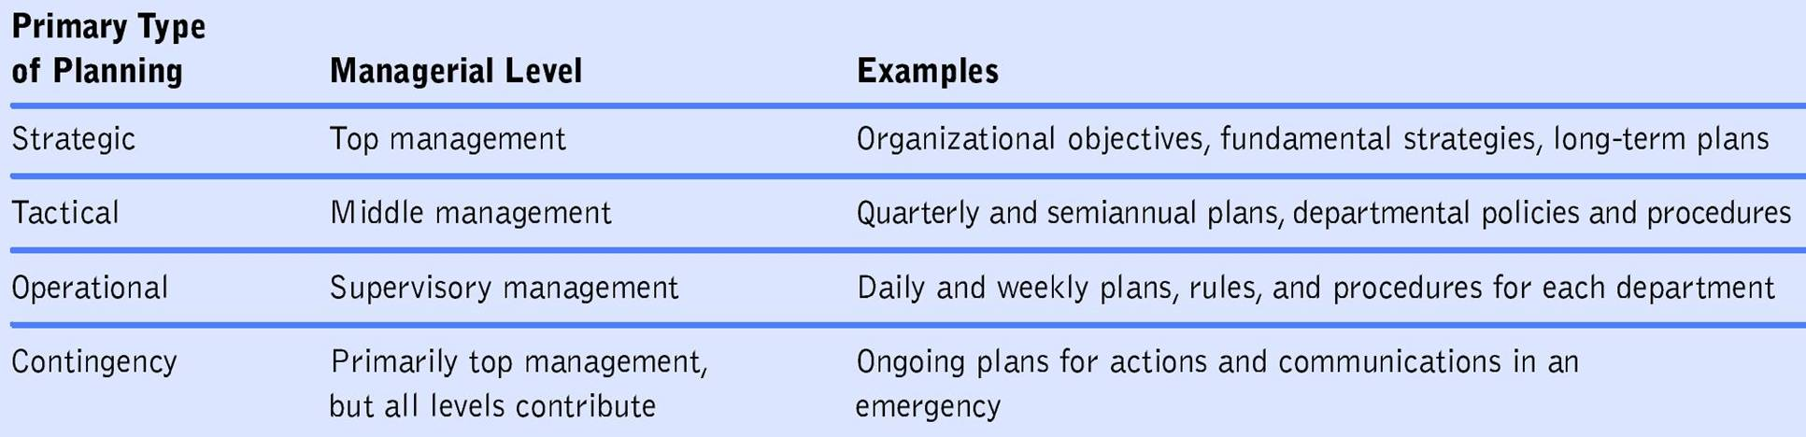
Importance of Planning
Planning at Different Organizational Levels
  Total time spent and the type of planning done differ according to the level of management
  Planning at Different Management Levels
Notes:
1. CEOs and other top-level managers focus mostly on long-range planning
2. Middle managers and supervisors do mostly tactical planning
3. Employees at all levels benefit themselves and the company by making plans to meet their own goals

Slide 17
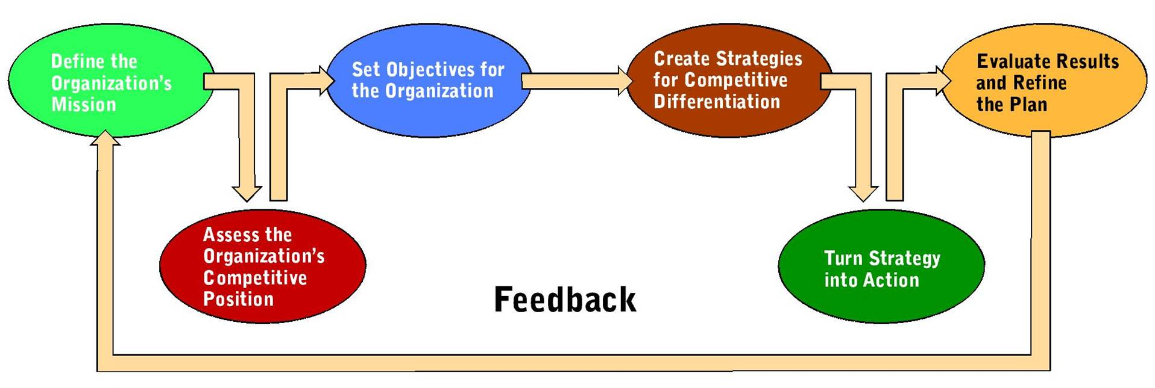
The Strategic Planning Process
Often makes the difference between an organization’s success and failure
Has formed the basis of many fundamental management decisions
Typically a six step process
Notes:
The first step of strategic planning is to translate the firm’s vision into a mission statement that explains its overall intentions and aims.
Next, planners must assess the firm’s current competitive position, using tools, such as SWOT analysis – which weighs the firm’s strengths, weaknesses, opportunities and threats – and forecasting.
Based on this information, managers set specific objectives that elaborate what the organization hopes to accomplish.
The next step is to develop strategies for reaching objectives that will differentiate the firm from its competition.
Managers then develop an action plan that outlines the specific methods for implementing the strategy.
Finally, the results achieved by the plan are evaluated and the plan is adjusted as needed.

Slide 18
The Strategic Planning Process
Defining the Organization’s Mission
  Mission statement—written explanation of an organization’s business intentions and aims
    Enduring statement of company’s purpose
    Guides the actions of people inside the firm
    Informs customers and stakeholders of the company’s underlying reason for existence
Notes:
Defining the Organization’s Mission
1. translating the firm’s vision into a written explanation of the firm’s business intentions and aims
2. an enduring statement of company purpose
3. guides the actions of employees and informs customers and other stakeholders of the company’s underlying reason for existence
4. may be simple in the final form, but the development is one of the most complex and difficult aspects of strategic planning

Slide 19
The Strategic Planning Process
Assessing Your Competitive Position
  Involves an examination of the factors that may help or hinder the organization in the future
  SWOT analysis—organized method of assessing a company’s internal strengths and weaknesses and its external opportunities and threats
Notes:
SWOT Analysis
a. an organized method of assessing a company’s internal strengths and weaknesses, and its external opportunities and threats
b. this planful review of reality leads to managers selecting the appropriate strategy to accomplish the organization’s goals
c. continues with an attempt to define the major opportunities and threats within the time frame of the plan
d. by addressing these potential obstacles, a firm can often overcome these potential problems

Slide 20
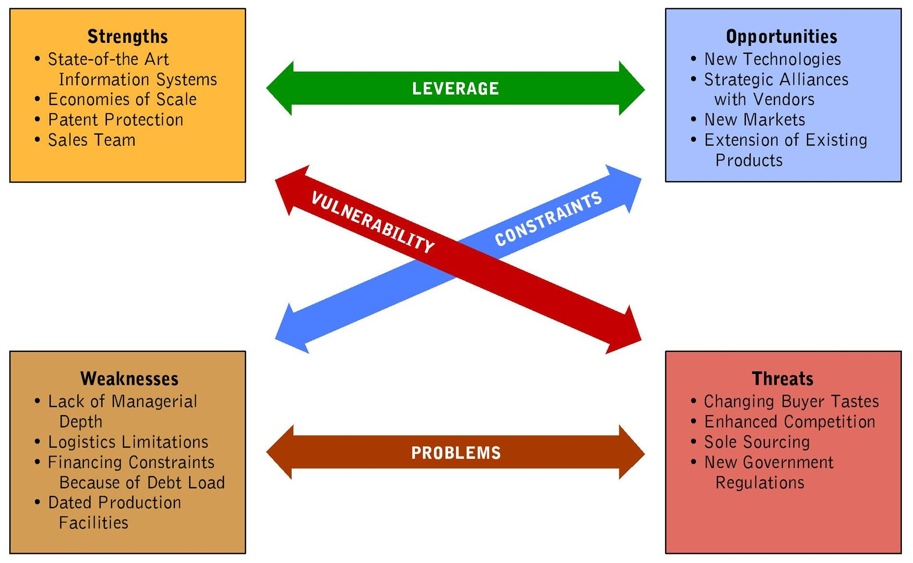
Elements of SWOT Analysis

Slide 21
The Strategic Planning Process
Establishing Objectives for the Organization
  Objectives—guideposts by which managers define the organization’s desired performance in such areas as profitability, customer service, growth, and employee satisfaction.

Slide 22
The Strategic Planning Process
Creating Strategies for Competitive Differentiation
  Competitive differentiation—unique combination of a company’s abilities and approaches to place it ahead of competitors
Notes:
1. the underlying goal of strategy development
2. the unique combination of a company’s abilities and approaches that place it ahead of competitors
3. Examples could include:
a. human resources
b. product innovation

Slide 23
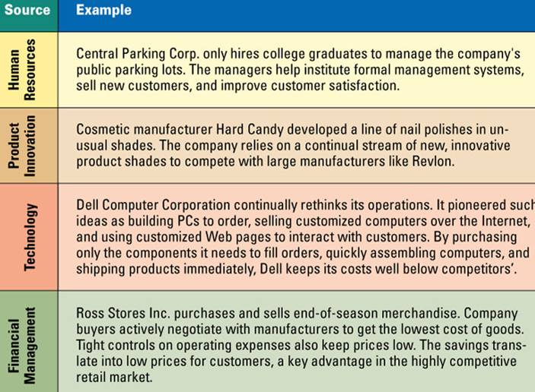
Sources of Competitive Advantage

Slide 24
The Strategic Planning Process
The Implementation Phase of Planning
  Strategy put into action by identifying the specific methods and deploying the resources needed to implement the intended plans
Monitoring and Adapting Strategic Plans
  Closely linked to implementation
  Involves establishing methods of securing feedback about actual performance
Notes:
Implementation: Turning Strategy into Action
1. begin to put strategy into action by identifying the specific methods and deploying the needed resources
2. in this stage, managers utilize human skills heavily
Monitoring and Adapting Strategic Plans
1. consists of monitoring and adapting plans when actual performance fails to match expectations
2. involves establishing methods of securing feedback about actual performance
3. common methods include:
a. comparison of actual sales and market share data with forecasts
b. utilizing information from suppliers and customers

Slide 25
Managers as Decision Makers
Decision Making—process of recognizing a problem or opportunity, evaluating alternative solutions, selecting and implementing an alternative, and assessing the results.
  Programmed decision—involves simple, common, and frequently occurring problems for which solutions have already been determined
  Nonprogrammed decision—involves a complex and unique problem or opportunity with important consequences for the organization
Notes:
Decision making is the process of recognizing a problem or opportunity and then finding a solution to it
1. Programmed Decisions involve simple, common and frequently occurring problems for which solutions have already been determined.
2. Nonprogrammed Decisions involve complex and unique problems or opportunities with important consequences for the organization

Slide 26
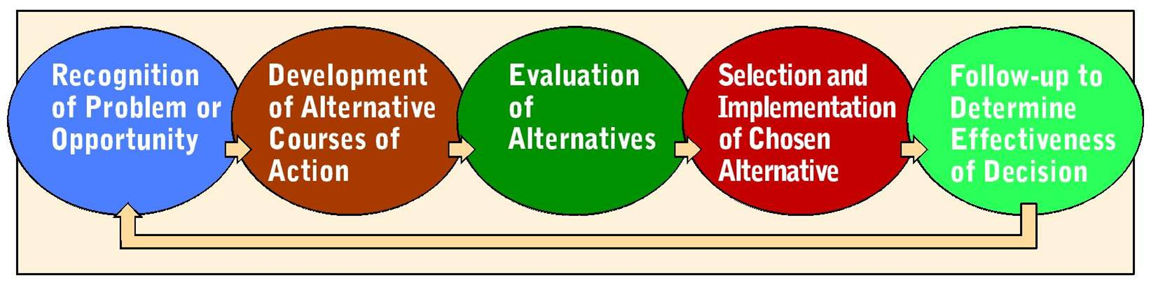
Managers as Decision Makers
How Managers Make Decisions
  Many rely on intuition when they lack enough information to determine the probable outcome of a decision
  Making good decisions involves taking risks
  Steps in the Decision-Making Process
Notes:
1. Utilizing intuition, gut feelings, instinct, or previous experience is a frequent method
2. However, information gathering and analysis can improve the quality of the decision, especially in important decisions
The steps in the decision-making process, which can be applied to both programmed and nonprogrammed decisions are:
recognition of problem or opportunity
development of alternative courses of action
evaluation of alternatives
selection and implementation of chosen alternative
follow-up to determine effectiveness of decision

Slide 27
Managers as Leaders
Leadership—ability to direct or inspire people to attain organizational goals.
Characteristics of a good leader often mentioned:
  Empathy & Self-awareness
  Objectivity & Courage
  Ability to inspire others
  Passion & Commitment
  Flexibility & Innovation
  Willingness to experiment
Notes:
Leadership is directing or inspiring people to attain organizational goals
1. successful companies have been found to have a common characteristic – powerful, visionary leaders
2. involves the use of power or influence, which may come from many sources, including:
a. the leader’s formal position within the organization
b. the leader’s expertise and experience
c. their forceful personalities – appropriate use of humor, energy, or enthusiasm

Slide 28
Managers as Leaders
Leadership Styles
  Autocratic leadership—boss makes decisions on their own without consulting employees
  Democratic leadership—involves subordinates in making decisions
Notes:
Autocratic – centered on the boss, who make decisions on their own without consulting employees and expect prompt implementation of instructions
Democratic – involves subordinates in decision making, and is employee centered

Slide 29
Managers as Leaders
Leadership Styles
  Free-reign leadership—leader believes in minimal supervision, leaving most decisions to subordinates
    Empowerment—practice in which managers lead employees by sharing power, responsibility, and decision making with them
Notes:
Free-rein leadership – believe in minimal supervision; leave most decision making to their subordinates; communicate with whomever is necessary and whenever needed
Empowerment – a practice in which managers lead employees by sharing power, responsibility, and decision making

Slide 30
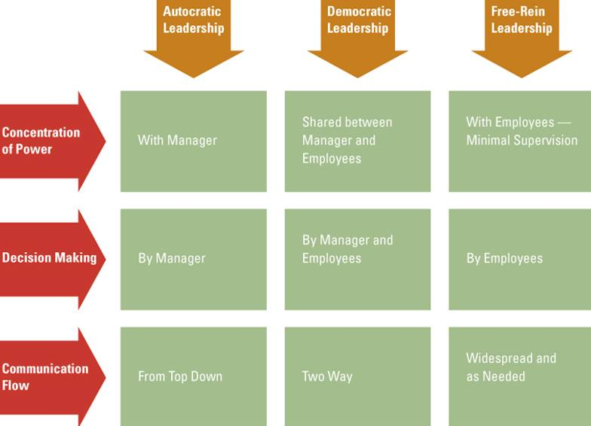
Comparison of Leadership Styles

Slide 31
Managers as Leaders
Which Leadership Style Is Best?
  Depends on function of the leader, subordinates, and situation
  Some leaders can’t work well with high participation of subordinates
  Some employees lack the ability or
  desire to assume responsibility
  Participative decision making may be better when time pressure is not acute
Notes:
The best leadership style depends on three elements:
the leader
the followers
the situation

Slide 32

Corporate Culture
An organization’s system of values, principles, and beliefs.
  Home Depot’s corporate culture emphasizes the importance of employees’ knowledge of the business and their enthusiasm.
Notes:
1. Corporate culture refers to an organization’s values, beliefs, and principles.
2. It is typically shaped by the firm’s founder and perpetuated through formal programs such as training, rituals, and ceremonies, as well as through informal discussions among employees.
3. Corporate culture can powerfully influence a firm’s success by giving it a competitive advantage.

Slide 33
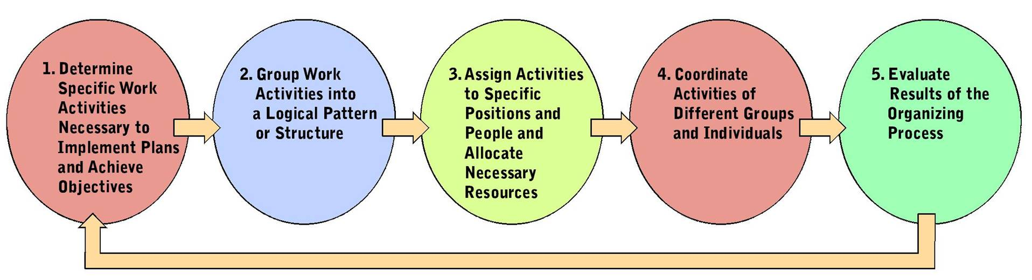
Organizational Structure
Organization—structured grouping of people working together to achieve common goals.
Steps in the Organizing Process
Notes:
A structured grouping that permits interactions among individuals and departments is needed to achieve common objectives and the company’s goals
The steps involved in organizing include:
1. Managers determine the specific activities needed to implement plans and achieve goals
2. They group these work activities into a logical sequence or structure
3. They assign work to specific employees and give the resources needed to complete the work assigned
4. Managers continue to coordinate the work of the different groups and employees
5. Managers evaluate the results of the organizing process and make appropriate adjustments

Slide 34
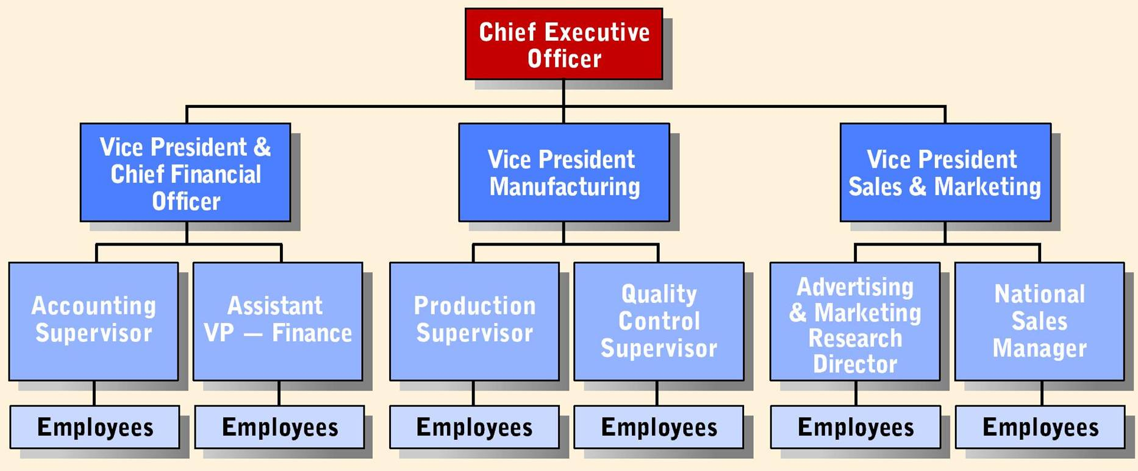
Organizational Structure
Organization chart—visual representation of a firm’s structure that illustrates job positions and functions
Notes:
Many factors influence the results of organizing, including:
1. A firm’s goals and competitive strategy
2. The types of goods or services it offers
3. The way it uses technology
4. Its size – growth requires greater complexity of structure
The outcome of the organizing process should result in a well-defined structure that informs people about reporting lines and how everyone contributes to the company’s mission
1. An organizational chart is the physical representation of the structure
2. Studying the organizational chart can help managers determine if the structure is appropriate for meeting the firm’s goals

Slide 35
Organizational Structure
Departmentalization—process of dividing work activities into units within the organization.
Major forms of departmentalization subdivide work by:
  Product
  Geographic Area
  Customer
  Function
  Process
Notes:
1. The process of dividing work activities into units within the organization, which lets employees specialize in certain jobs, thus promoting increased efficiency and effectiveness
2. A single company may utilize several forms.
3. As companies grow and change, restructuring is common.
4. The five major forms of departmentalization are:
a. Product departmentalization – organizes work units based on the goods and services a company offers
b. Geographic departmentalization – organizes units by geographic regions either within the country or throughout the world
c. Customer departmentalization – offers a variety of goods or services targeted to different types of customers
d. Functional departmentalization – organizes work units according to business functions
e. Process departmentalization – work units are arranged in consideration that multiple work processes may be needed to complete production

Slide 36
Organizational Structure
Major forms of departmentalization subdivide work by:
  Product—Organizes work units based on the goods and services offered
  Geographic—units organized by geographic region within a country
  Customer—organization that offers a variety of goods and services targeted to different types of customers might structure itself based on customers served

Slide 37
Organizational Structure
Major forms of departmentalization subdivide work by:
  Functional—work units organized according to business functions such as finance, marketing, human resources, and production
  Process—units organized by work processes required to complete production of goods

Slide 38
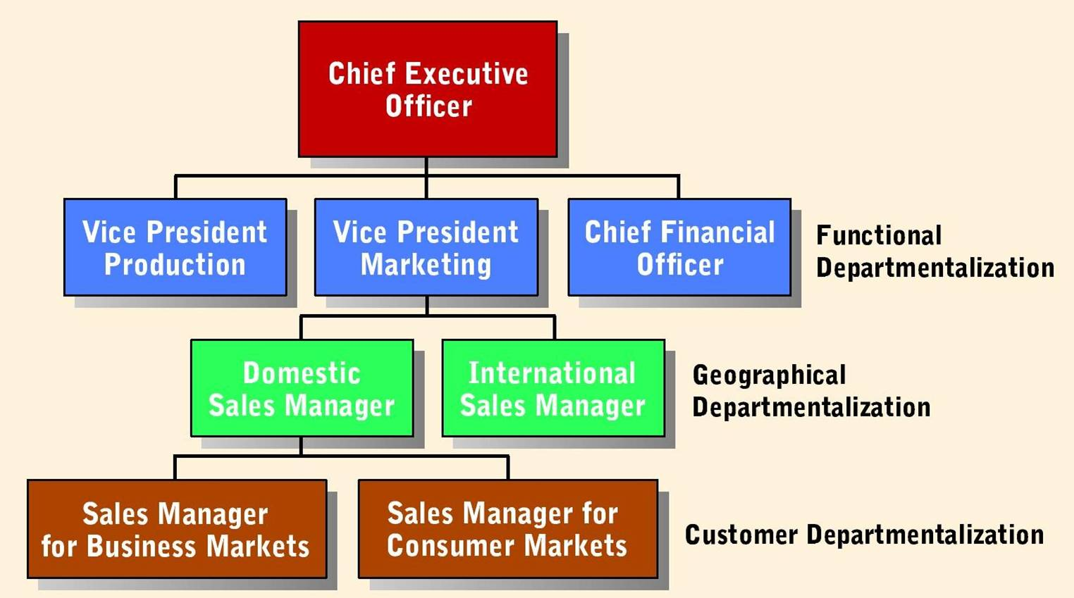
Different Forms of Departmentalization with One Company

Slide 39
Organizational Structure
Delegating Work Assignments
  Delegation—act of assigning work activities to subordinates.
    Accountability
    Authority
    Responsibility
  Span of Management
    (Span of Control)—number of subordinates a manager can supervise effectively.
Notes:
1. Delegation – the act of assigning activities to employees
a. frees managers’ time
b. assigns responsibility and authority to employees
2. Accountability – means that employees are responsible for the results and thus must accept the consequences of their actions
3. Authority and responsibility tend to move downward in the hierarchy; whereas, accountability moves upwards
4. Spans of Management or span of control – the number of subordinates a manager can effectively supervise. Varies widely depending on:
a. the type of work being performed
b. employees’ training and experience
c. focus on reduction of personnel costs
d. the use of information technology
e. the other work of the manager

Slide 40
Organizational Structure
Delegating Work Assignments
  Centralization—retains decision-making at the top of the management hierarchy
  Decentralization—locates decision-making at lower levels
Notes:
1. Centralized organizations retain decision making at the top levels of management.
2. Decentralized organizations locate decision making at the lower levels.
3. Current trend towards decentralization

Slide 41
Organizational Structure
Types of Organizational Structures
  Line Organization
  Establishes a direct flow of authority from the chief executive to subordinates
    Chain of command—set of relationships that indicates who directs which activities and who reports to whom
Notes:
Line Organizations
a. the oldest and simplest form, establishes a direct flow of authority from the chief executive to subordinates
b. has a clear chain of command – a set of relationships that indicates who gives direction to whom and who reports to whom
c. helps to prevent buck passing
d. disadvantage is that managers are held accountable even though they may lack expertise in that area and can also be easily overburdened with administrative details
e. most effective in small organizations

Slide 42
Organizational Structure
Types of Organizational Structures
  Line-and-Staff Organizations—
  combines the direct flow of authority of a line organization with staff departments that serve, advise, and support the line departments
    Line manager
    Staff manager
Notes:
Line-and-Staff Organizations
a. combines the direct flow of authority and quick decision making and communications of a line organization with staff departments’ expert knowledge and the ability to serve, advise, and support the line departments
b. Line departments participate directly in decisions that affect the core operations.
c. Staff departments lend specialized technical support.
d. Line managers form a part of the primary line of authority and interact directly with the various business functions, such as finance.
e. Staff managers provide information, advice, or technical assistance to aid line managers; do not have authority to give orders outside their own departments.
f. Most appropriate in mid-sized and large corporations.

Slide 43
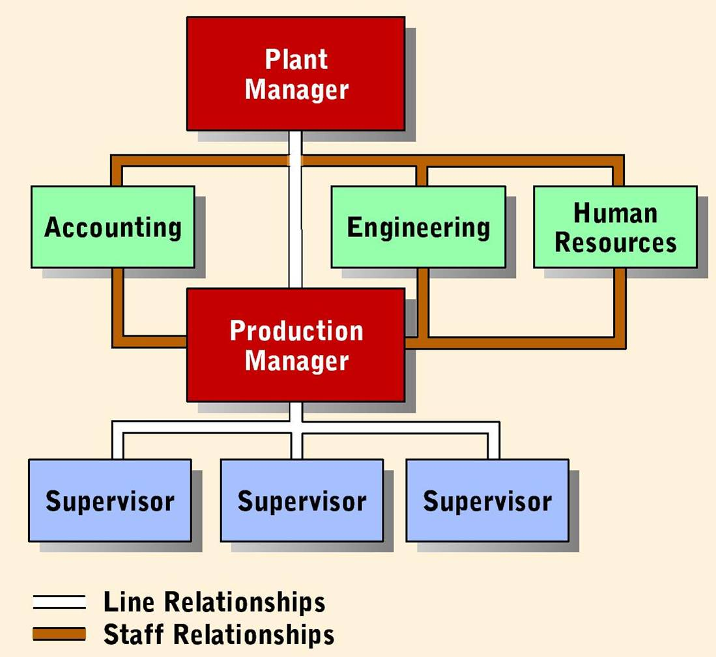
Line-and-Staff Organization

Slide 44
Organizational Structure
Types of Organizational Structures
  Committee organization—structure that places authority and responsibility jointly in the hands of a group of individuals rather than a single manager
  Matrix structure—links employees from different parts of the organization to work together on specific projects
Notes:
Committee Organizations
a. places authority and responsibility jointly in the hands of a group of individuals rather than a single manager
b. The committee evaluates ideas in terms of prescribed criteria.
c. tend to act slowly and conservatively
d. additionally, can make decisions by compromising conflicting interests rather than by choosing the best alternative
Matrix Organization
a. increasingly common in organizations
b. links employees from different parts of the organization to work together on specific projects
c. each employee reports to two managers – one line manager and one project manager
d. the horizontal authority is temporary and is over when the project is completed
e. the vertical authority comes from their permanent functional department

Slide 45
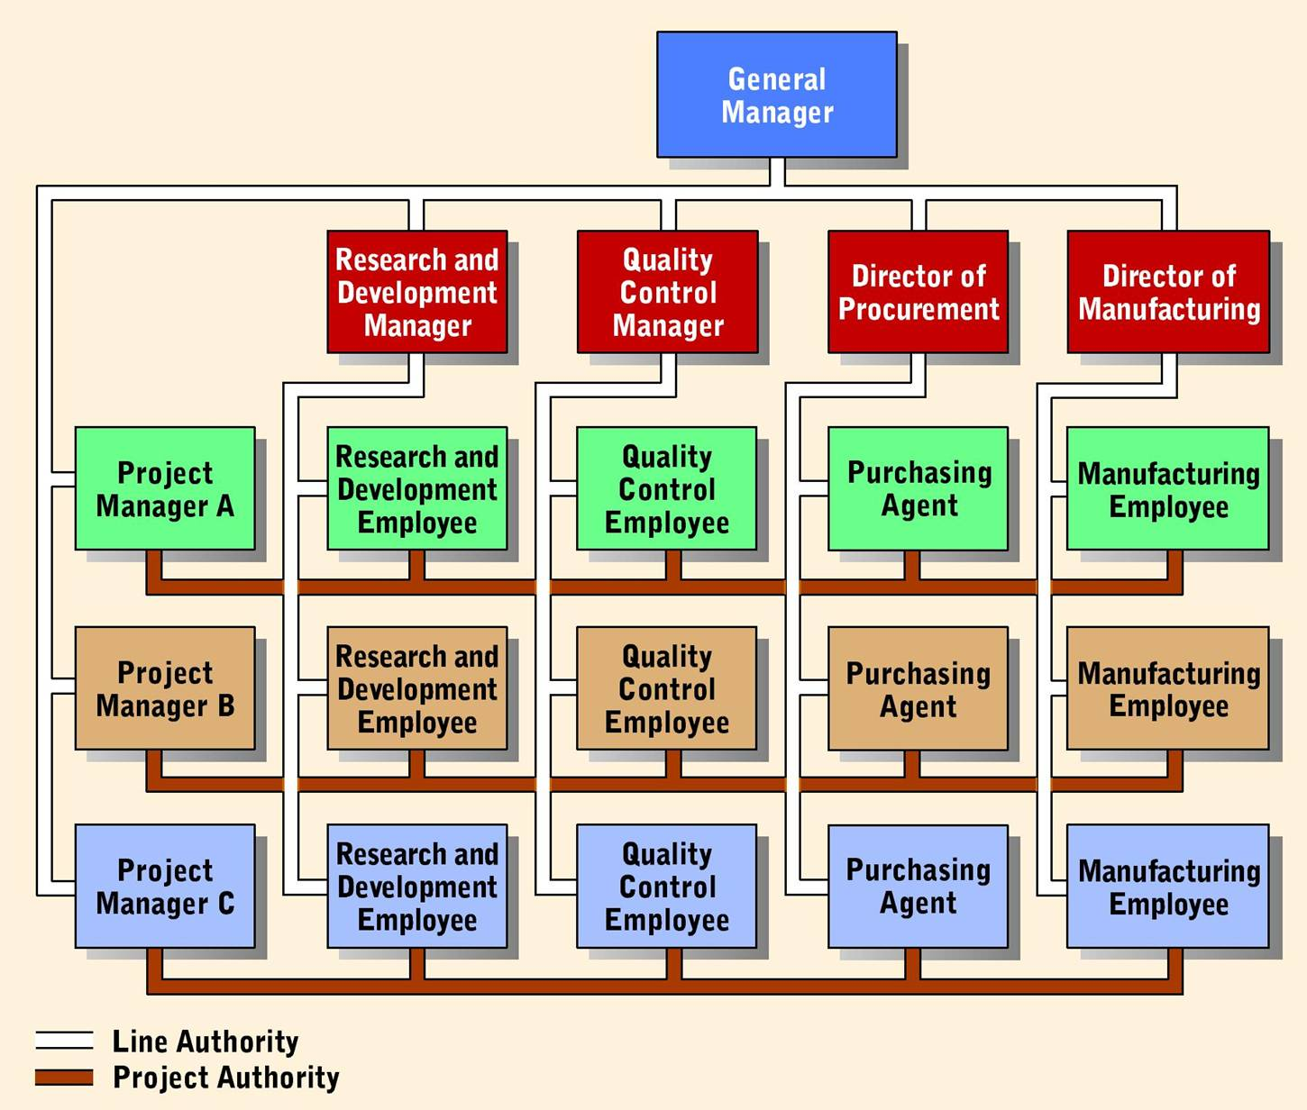
Matrix Organization

Slide 46
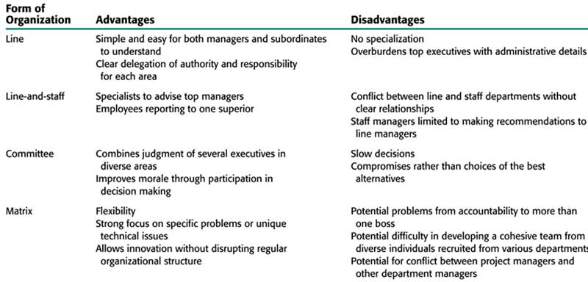
Comparing the Four Organization Structures

